Slide 1

OSCE workshop
The 4th family medicine review course
Dr. Sara AlHammouri

Slide 2
Counseling
Neurology
Headache.
Anticonvulsants (breast feeding/pregnancy).

Slide 3


Slide 4
Headache
You may get a patient with migraine and you will be asked to manage and start prophylactic medications.
Know the symptoms of migraine headache.
Red flags.
Indications for prophylactic treatment.
Pharmacological vs. non pharmacological management (acute, prophylaxis, life style advice, headache diary)
Containdications
Passmedicine

Slide 5


Slide 6
Anticonvulsants (breast feeding/pregnancy)
Aim for monotherapy.
No indication to monitor antiepileptic drug levels.
Stress that the danger of not taking the antiepileptic is more life threatening to the mother and baby than the drug itself.
Breast feeding is generally considered safe for mothers taking antiepileptic with the possible exception of barbiturates.
All women thinking about becoming pregnant should be advised to take folic acid 5mg per day before pregnancy to minimize the risk of neural tube defects.

Slide 7
Anticonvulsants (breast feeding/pregnancy)
Medication | Teratogenic effect
Sodium valproate | neural tube defects
Carbamazepine | least teratogenic of the older antiepileptic
Phenytoin | cleft palate given vitamin K in the last month of pregnancy to prevent clotting disorders in the newborn
Lamotrigine | dose may need to be increase in pregnancy

Slide 8
Counseling
Endocrinology
Diabetes Mellitus ( follow up, prediabetes)
Thyroid diseases (hypothyroidism, subclinical hypothyroidism). → will be mentioned in the Data station.

Slide 9


Slide 10
Prediabetes
Screen asymptomatic adults for Diabetes mellitus if:
BMI ≥25 kg/m².
BMI≥ 23 kg/m². (Asian American)
And one or more Risk Factor:
Physical inactivity.
1st degree relative with DM.
High risk race/ethnicity.
Women with GDM or delivered baby > 4kg.
HDL < 0.9 mmol/l, TG > 2.8 mmol/l.
HbA1c 5.7 or more, IFG or IGT.
Conditions associated with insulin resistance (metabolic syndrome,
obesity, pregnancy, stress, inactivity, steroids).
CVD history.
If no risk factor testing start at 45y.
If normal, repeat every 3 years.
If prediabetes, test yearly.

Slide 11
Prediabetes Diagnosis
HbA1c
5.7 - 6.4 %
IFG (impaired fasting glucose)
5.6 - 6.9 mmol/l
IGT (impaired glucose tolerance)
2 hrs post glucose 75g OGTT
7.8 - 11 mmol/l

Slide 12
History | Examination | Investigation
Hx of symptoms of hyperglycemia: Polyuria Polydipsia Weight loss |  | Annual HbA1c
Hx of complications of DM: Neuropathy Stoke/TIA (weakness, speech..) Heart failure (dyspnea, PND, lower limb edema) Chest pain Repeated infections | Fundoscopy (retinopathy) Blood pressure measurement. Foot examination. | Urine microalbumin (nephropathy)
Risk factors: Smoking Obesity Hyperlipidemia Prior GDM (female) Family history of premature CVD death < 55y m and <65 f. Physical inactivity /Diet history. | BMI. Waist circumference. | Lipid profile

Slide 13
Management
R Reassure the patient that this condition if managed can delay the onset of DM and prevent the complications.
And it is not diabetes
A Advice:
1. Diabetes self-management education (DSME): the ongoing process of facilitating the knowledge, skills and ability necessary for diabetes self-care.
2. Life style modification:
3. Weight loss: 7 % of body weight.
4. Increase physical activity:
150 min/w → moderate intensity exercise.
Spread over 3 d/w.
No more than 2 consecutive days without exercise.
5. Diet modification (Mediterranean diet recommended):
High in fruits/vegetables/whole grains/beans/nuts/seeds/olive oil)
Low to moderate fish/poultry/dairy products)
Low red meat.
6. Screening and treatment of modifiable CVD risk factors (obesity/ hyperlipidemia/ HTN/smoking)

Slide 14
P Prescribe
Metformin 850mg bd (Diabetes prevention program trial) for the following patients:
BMI 35 kg/m² or more.
Age < 60 y.
Women with prior GDM.
(Start metformin 500mg for not less than 2 weeks then increase the dose to bd to avoid GI side effect).
R Referral needed for dietician if necessary.
I Investigations (yearly HbA1c and Lipid profile).
O Follow up counseling is important for successful management (at least every 2 months)

Slide 15
Counseling
Pediatrics:
Nocturnal enuresis.
Constipation.
Toilet training.
Head lice.
Febrile convulsions.
Breast feeding and weaning.
ADHD
Down syndrome

Slide 16
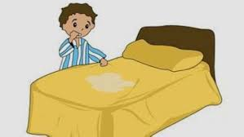

Slide 17
Nocturnal enuresis
Management
- < 7y → no need for treatment → resolve spontaneously. (nappy alarm)
> 7y → refer to enuresis clinic. (Desmopressin).
NICE advise:
'Consider whether alarm or drug treatment is appropriate, depending on the age, maturity and abilities of the child or young person, the frequency of bedwetting and the motivation and needs of the family'.
Generally:
anuresis alarm is first-line for children under the age of 7 years
Desmopressin may be used first-line for children over the age of 7 years, particularly if short-term control is needed or an enuresis alarm has been ineffective/is not acceptable to the family

Slide 18
Management RAPRIOP:
R reassurance →reassure the child and parents that the problem is not their fault.
Explain causes
Delay in maturation (resolve with time).
1-2% have physical abnormality (UTI).
Congenital anomalies/sacral nerve disorders/DM/Diabetes insipidus/pelvic mass.
Emotional distress (dry → wetting bed).

Slide 19
Affects
Runs in families.
6 year old | 30%
10 year old | 10%
12 year old | 3%
18 year old | 1%

Slide 20
A advice
advise on fluid intake, diet and toileting behavior
Avoid fluids before 1 h of bed time.
Urinate before going to bed.
Record wet-dry nights.
Star charts →reward systems .
NICE recommend these 'should be given for agreed behavior rather than dry nights e.g. Using the toilet to pass urine before sleep

Slide 21
P prescription:
1. enuresis alarm:
First few weeks, the child wakes after complete emptying.
Next few weeks, partial inhibition.
Wake up before the bladder empty in response to contraction.
Should be used for at least 3 weeks, and until dry for 2 weeks.
70% effective, relapse in 10-15%.

Slide 22
P prescription:
2. Desmopressin
Synthetic version of antiduiretic hormone.
Tablet (taken at night)
SE: headache, nausea, nasal congestion, nosebleed, sore throat, cough, flushing, mild abdominal cramps.
May cause water overload → no water before 1 hr and after 8 hrs of taking.
To cover holidays (short term effectiveness 4-6w).

Slide 23
P prescription
3. Anticholinergics/TCAs :
  Do not use tricyclics as the first‑line treatment
  Consider imipramine for children and young people with bedwetting who have not responded to all other treatments
  Consider an anticholinergic combined with desmopressin for children and young people that has not responded to an alarm and/or desmopressin

Slide 24
R no need for referral unless there is physical problem that need to be treated or investigated by pediatrician.
I urinalysis, FBS.
O can be seen after 2 or 4 weeks to see response according to type of treatment.

Slide 25


Slide 26
Toilet training
Children should be without nappies by day → 2-3 y.
By night → 2-5 y.
General rules:
Wait until child is ready.
Pick a good time (not timing of going to school).
Until child + parents are confident about child’s ability to use toilet, continue using nappies when out and at night.

Slide 27


Slide 28
Constipation
Diagnose constipation if 2 of:
Abnormal stool pattern: (<3 stool per wk, hard or rabbit dropping stool, overflow soiling)
Symptoms associated with defecation: (straining, poor appetite, abdominal pain)
History of previous constipation or anal fissure

Slide 29
Constipation
Management:
Explain:
The frequency at which children open their bowels varies widely, but generally decreases with age from a mean of 3 times per day for infants under 6 months old to once a day after 3 years of age.

Slide 30
Constipation
The majority of children have no identifiable cause - idiopathic constipation. Other causes of constipation in children include:
dehydration
low-fibre diet
medications: e.g. Opiates
anal fissure
over-enthusiastic potty training
hypothyroidism
Hirschsprung's disease
hypercalcaemia
learning disabilities

Slide 31
Constipation
A advice (increase fluid intake, increase fiber rich diet)
P prescribe
Comprehensive program, including use of laxative, behavior changes and dietary changes.
There are 4 general steps:
Disimpaction (constipation with fecal incontinence, stool mass palpable on DR, abdominal examination or xray, hx of incomplete or infrequent evacuation)
Prolonged laxative treatment and behavior therapy to achieve regular evacuation and avoid recurrent constipation.
Dietary changes (primarily increasing fiber content) to maintain soft stools.
Gradual tapering and withdrawal laxatives as tolerated.
R refer : If not controlled.

Slide 32
The goal of therapy is the passage of soft stools, ideally once per day, and no less than every other day.

Slide 33
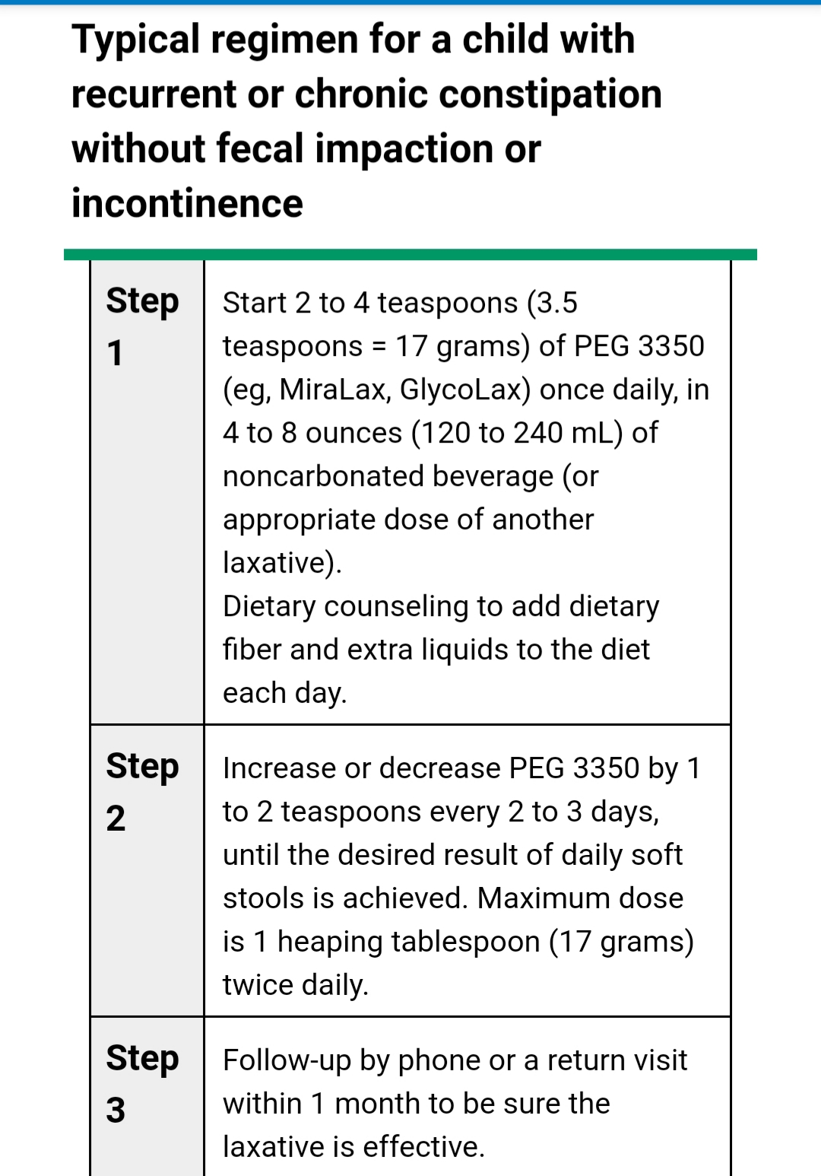

Slide 34
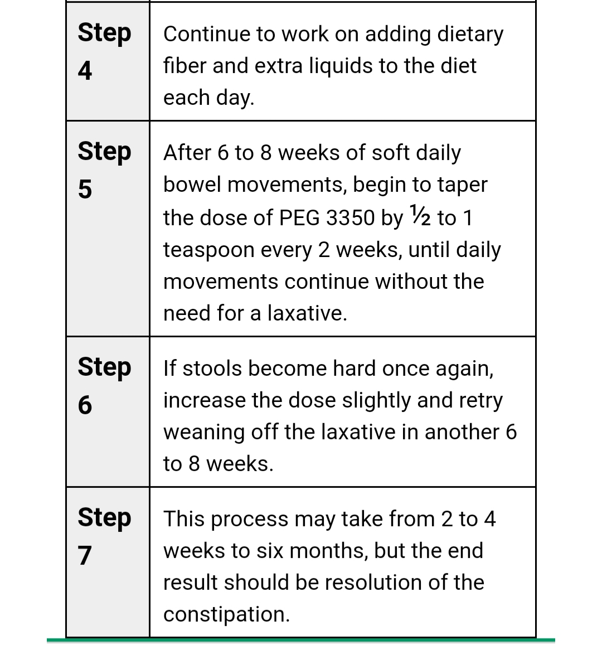

Slide 35
Encopresis
Encopresis : Fecal soiling occur during the day.
If child has bowel control but passes stool in unacceptable places → emotional → Refer for child psychiatry.
If a firm stool is passed occasionally in the toilet but usually in the pants → developmental delay (mental/social) firm consistent training program similar to motivational counseling for enuresis.
If soft stool oozes out causing the child to constantly soil himself and smell faeces → consider overflow incontinence secondary to chronic constipation.
Treat constipation → refer if not settling.

Slide 36


Slide 37
Head lice
Management RAPRIOP
R reassurance / E explain
Head lice (also known as pediculosis capitis or 'nits') is a common condition in children caused by the parasitic insect
Most common in children aged 4-11y (f > M).
Infest clean as often as dirty hair.
Spread by close head to head contact, it does not fly or jump.
Present as itchy scalp, could be asymptomatic.
A advice
Household contacts should be examined and treated if infested
Bedmates should be treated prophylactically.
School exclusion is not advised for children with head lice (lice often are present for weeks prior to detection)

Slide 38
P prescription
Treatment is only indicated if living lice are found
A choice of treatments should be offered:
Dimeticone lotion or spray (rub into dry hair and scalp in evening, allow to dry naturally, then shampoo off the next morning, repeat after 7 days).
Insecticides 4 types:
malathion → used with caution in pregnancy
phenothrin/permethrin → avoid in pregnancy(first line/second line)
carbaryl is reserved for third line
2 applications 7 days apart
Mechanical clearance wet-comb ‘bug busters’ conditioned hair with fine tooth comb.
Others methods electric comb, aromatherapy, herbals (no evidence).

Slide 39
I investigations
fine-toothed combing of wet or dry hair to visualize the lice and confirm diagnosis
P prevention
Detection combing
Recommend school examination

Slide 40
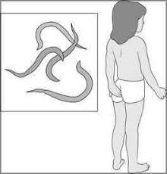

Slide 41
Enterobiasis (pinworm)
Management RAPRIOP
R reassurance and E explanaition
Autoinfection occurs by scratching the perianal area → mouth.
Person to person transmission by hand.
Asymptomatic in most patients but the most common symptom is perianal itching, predominantly at night.
occasionally, abdominal pain, nausea and vomiting develop.
A advice
Hygiene
Simultaneous treatment of the entire household is warrented, given high transmission rates among families.
P prescription
Treatment with Abendazole, mebendazole or pyrantel promoate.

Slide 42
Mebendazole
Adult dosing (pinworm infection):
100 mg PO as single dose
If the patient is not curred 3 wk after treatment, a second course of treatment is advised.
Adult dosing (whipworm, hookworm, roundworm infections):
100 mg PO bid x 3 days
If the patient is not cured 3 wk after treatment, a second course of treatment is advised
Pediatrics dosing (similar to adult dose)
Safety and effectiveness in pediatric patients < 2 years of age have not been established.

Slide 43
R referral → no need except if diagnosis tools needed.
I investigations
Diagnosis via examination of cellophane tape for eggs after pressing to the perianal skin.
Stool examination is limited since worms and eggs are not generally passed in stool.
O follow up after 3 weeks to check improvement and response to tretament.

Slide 44
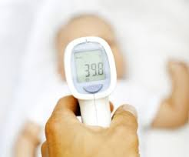

Slide 45
Febrile convulsion
Anxious father with his child who has febrile convulsion.
Management RAPRIOP
R reassurance and E explanation:
It is a convulsion associated with fever that are divided into simple and complex.
Common problem 4% in general population.
Between the age of 6m-6y
2% chance of developing epilepsy which is the same as the general population.
Recurrence rate is 30-40%.
Genetic predisposition.

Slide 46
A advice
give antipyretic whenever the child is febrile
if the child is having a convulsion →
do not panic
put him in lateral position
if available give rectal diazepam if seizure did not stop after 5 min, if not aborted bring to nearest clinic and give another diazepam after 5 min.
P prescription (antipyretic, rectal diazepam)

Slide 47
R referral refer if:
First febrile seizure.
Not assessed after the first seizure.
Uncertain diagnosis.
> 15 min, focal, recurred in the same illness or within 24 hrs or incomplete recovery.
Anxious parents although reassurance was given.
Suspected serious cause for the seizure.

Slide 48


Slide 49
Breast feeding/ weaning
Recommendation is to exclusive breast feeding until the age of 6 months
Feed on need.
Signs of hunger (fuss, sucking, moving lips)
No other fluids including water are recommended.
Advantages to mother and child.
Contraceptive method → exclusively breast feeding for 6 months and amenorrhea.
Vitamin D supplementation.
Storage of breast milk (4 h → room T, 48 h → Fridge, 3 m → Frozen).
Complementary feeding:
Rice (fortified with iron) for 1 month.
Vegetables (broccoli, pumpkin) high in vit A and iron.
2-3 tablespoons porridge or well mashed 2-3 X/d.
At 8 m → small chewable items.
At 9 m → start meat.
2-5 y → as adult.
Introduce each type at a time for 3-4 days.

Slide 50


Slide 51
ADHD
Attention Deficit Hyperactivity Disorder (ADHD) is characterised by:
extreme restlessness
poor concentration
uncontrolled activity
impulsiveness

Slide 52
ADHD
Management RAPRIOP
Explain:
ADHD ( attention deficit hyperactive disorder) is a common disorder affecting the child’s behavior.
Often present with the child being restless, easily distracted and having a short attention span.
Can affect the child’s ability to function on a day to day basis (e.g. school, social function, home).

Slide 53
Advice:
Dietary advice:
Balanced diet, good nutrition
regular exercise for children, young people and adults with ADHD.
Do not advise elimination of artificial coloring and additives from the diet.
Recommend diary of food and drink if parents suggest particular link with foods.
Do not advise or offer dietary fatty acid supplementation for treating ADHD in children and young people.

Slide 54
ADHD
Prescribe:
First line treatment: Talking therapies (family therapy, group CBT for older children, educational programs)
Prescribe medication (initiated by a specialist), reserved for those with severe symptoms and impairment or for those with moderate levels of impairment who have refused or did not respond to non‑drug interventions.

Slide 55
ADHD
Methylphenidate (Ritalin)
Side-effects: abdominal pain, nausea, dyspepsia.
Growth is not usually affected but it is advised to monitor growth during treatment every 6 months.
The BNF also advises monitoring for psychiatric disorders and checking blood pressure/pulse every 6 months.

Slide 56
ADHD
Refer:
Educational programs/group CBT.
Specialist for assessment/initiation of medication.
Dietician if a link with food and behavior has been identified.

Slide 57
ADHD
Investigations:
Not routinely required, there is no single test to diagnose ADHD.
Follow up:
Offer the patient a convenient follow up appointment as relevant to their needs.

Slide 58


Slide 59
Down syndrome
What do you need to know:
Who is at risk to have a baby with Down syndrome.
What are the causes of having a baby with down syndrome (genetics).
Risk of having another child with down syndrome.
Genetic counseling and screening tests available.
What are the clinical features (learning disabilities)
What are the co-morbidities (cataract, diabetes, leukemia, hypothyroidism).
What are the social facilities available.
What are the learning facilities available.
what management needed (multidisciplinary)

Slide 60
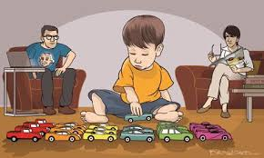

Slide 61
Autism
What do you need to know:
Biological based neurodevelopmental disorder.
Persistent deficits in social communication and social interaction and restricted, repetitive patterns of behavior, interests and activities of different spectrums and severity.
Language problems
Lack of eye to eye contact
Delayed socialization
Difficulties with routine
Temperament
Diagnosis should be confirmed by a specialist.
All children with suspected autism have to undergo hearing tests.
There are societies and schools for children with autism.
Support to parents and caregivers.
Vaccination and autism.

Slide 62
Counseling
Surgery
Obesity.
Breast cancer screening.

Slide 63


Slide 64
Obesity (bariatric surgery)
Referral cut off, with risk factors →BMI > 35, no risk factors →BMI > 40.
Consider surgery for people with severe obesity if:
BMI > 40 or between 35-40 with other conditions that may improve with weight loss (DM/HTN).
Non surgical measures tried for 6 m with no benefit.
Receiving or will receive specialist management.
Fit for surgery and anesthesia.
Commit for long term follow up.

Slide 65
Consider surgery as first line for (adults with BMI > 50, orlistat if waiting for surgery).
Which surgery:
BMI 30-39 → LAGB.
BMI > 40 → gastric bypass or sleeve.
BMI > 60 → malabsorptive procedures biliary pancreatic diversion.

Slide 66


Slide 67
Breast cancer screening
Major factors used to determine a risk category, based on a patient’s history, are:
Personal history of ovarian peritoneal or breast cancer.
Family history of breast, ovarian, or peritoneal cancer.
Genetic predisposition (BRCA or other genetic markers).
Radiotherapy to the chest between age 10 and age 30.

Slide 68
Thank you

